Slide 1
An Introduction to:
Snehan
Gorain
Course Code:TEJ1OP:01
Course Name: Exploring Computer Engineering
Semester: 1
Year: 2014
Teacher: Mr Buffone
Date: September 10

Slide 2
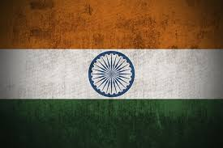

Background
I am a Hindustani (Indian) Muslim
Born in British Columbia
Born in Trail
Moved to Toronto at the age of 5

Slide 3
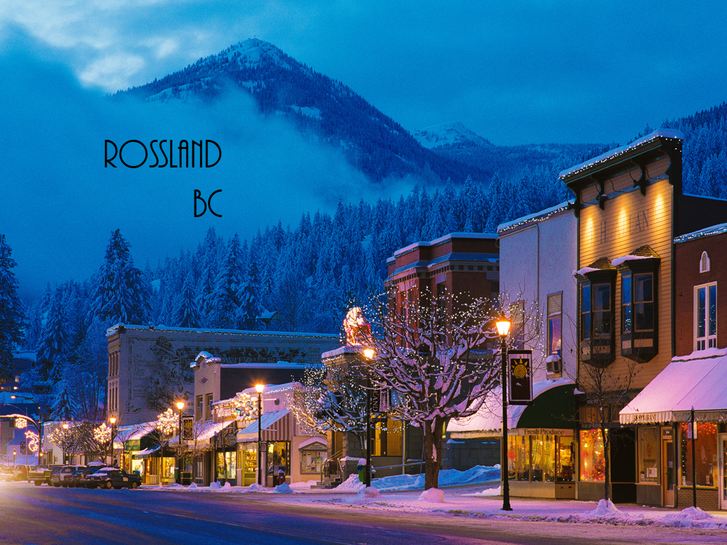
Rossland, the Ski town

Slide 4
Family
Dad- Works at Barrick
Mom- Worked in exporting fabric, but starting of as children's book Author
Sister- In grade 3

Slide 5
Schools I have been to
Mary McChormick for JK
Alan Howard Waldorf School (Now called The Waldorf Academy)
Homeschooled
Rawlinson Community School

Slide 6
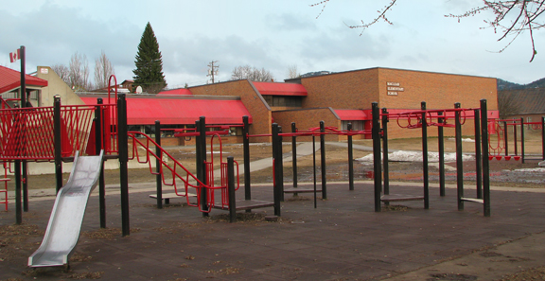
Mary McChormick (Rossland BC)
My First school. Attended Senior Kindergarten here.

Slide 7
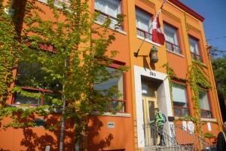
The Waldorf Academy
Attended SK and Grade 1 here

Slide 8
Homeschooled
I was Homeschooled for Grades 2 and 3. It really “smartened” me up.

Slide 9
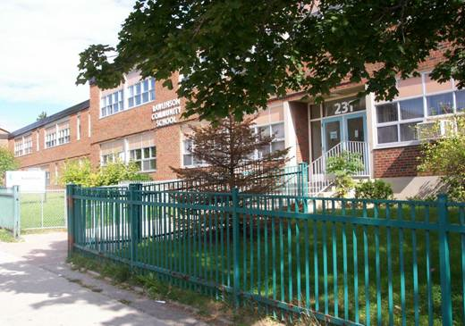
Rawlinson Community School
Attended the Extended French Program.
I attended Grades 4-8 here.

Slide 10
Hobbies

Slide 11

Reading
My Favourite Books
The Kite Runner
A Hundred Thousand Suns
Lethal Spice
The Mountains Echoed

Slide 12
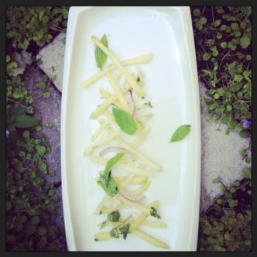
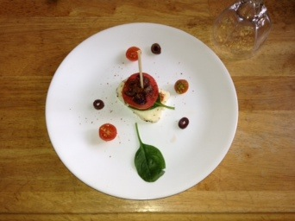
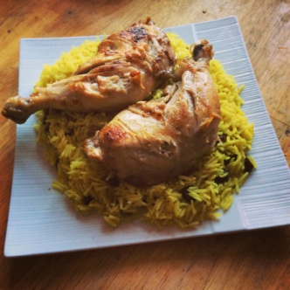
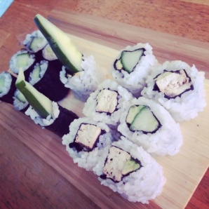
Cooking
I love cooking food from different countries. I’ve cooked food from
Thailand
Italy
France
Morocco
India
Middle Eastern/ Mediterarrian
Japan

Slide 13
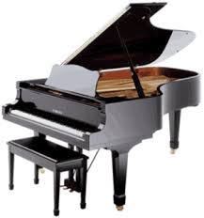

Piano
Self Taught until Grade 3 piano
Passed Grade 6 Exams
I am now in Grade 7 piano

Slide 14
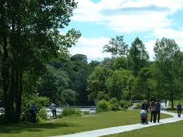
Trekking
Trekking, Biking and Rollerblading

Slide 15
Sports I like

Slide 16
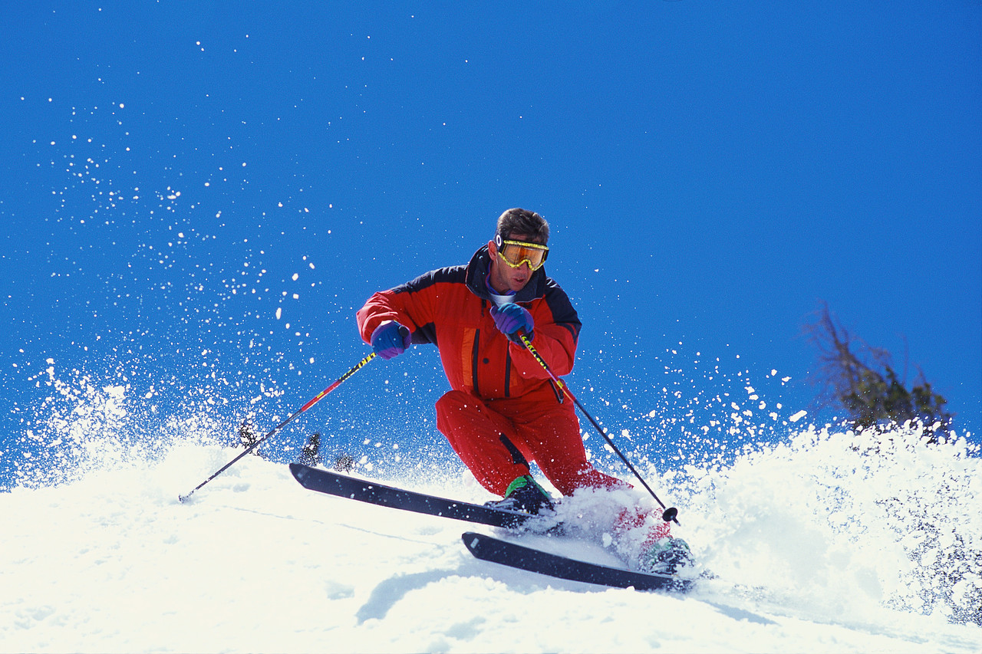
Skiing
There’s not sport as thrilling as skiing

Slide 17
Ultimate
Learned about it in Grade 7
Joined my schools Ultimate team in Grade 8

Slide 18
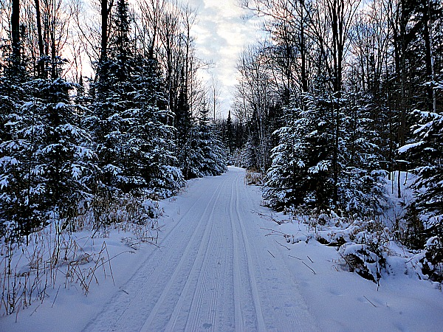
Trekking and Crosscountry Skiing

Slide 19
Music I listen to

Slide 20
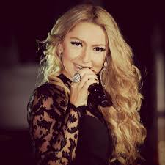
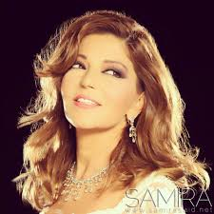
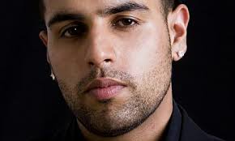
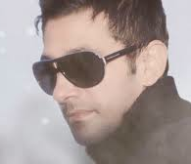

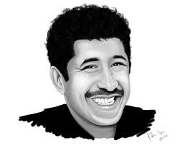
World Movies and World Music
I listen to Music from all over the world. I listen to music from:
Lebanon
Afghanistan (Farsi and Pashtu)
India (Bollywood and Punjabi)
Morocco
Algeria
Iran
Korea
Thailand
Japan
China (Cantonese and Mandarin)
France

Slide 21
My Career Plan

Slide 22
Jobs I am Interested in
I currently don’t have a career that I’m sure I am sure to pursue.
Chef
Entrepreneur
A job in Business
Health, Wellness and Fitness

Slide 23
Where I want to Live
Helsinki
Santiago (del Chile)
Istanbul
Ottawa

Slide 24
Languages I speak and Languages I want to learn

Slide 25

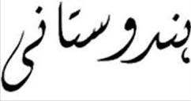


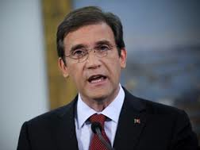
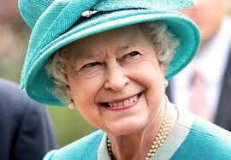

What I speak
English
A good Amount of French
Urdu (language of India).
I also self taught myself very little Portuguese. I use it to say simple things to the Portuguese people in my neighborhood.
Òla
Hello

Slide 26
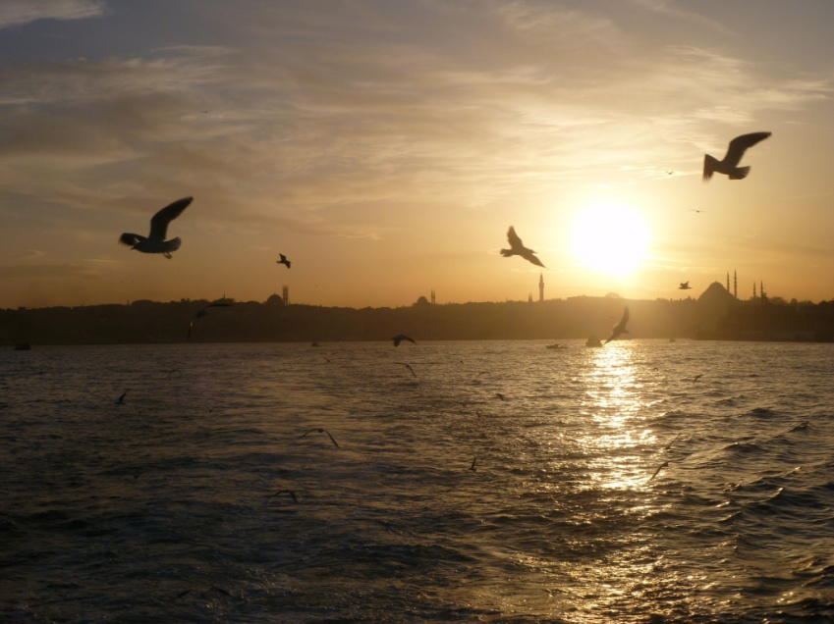
5 top language I want to learn
Arabic
Portuguese
Mandarin
Farsi
Turkish
I love learning new languages

